Slide 1
Lossless compression vs. Lossy compression
Lossless compression restores and rebuilds file data in its original form after the file is decompressed. For example, when a picture's file size is compressed, its quality remains the same.
The file can be decompressed to its original quality without any loss of data. This compression method is also known as reversible compression.
With this method, although file sizes are reduced, the reduction is less compared to reduction using lossy compression.
In lossy compression, the data in a file is removed and not restored to its original form after decompression. Specifically, data is permanently removed, which is why this method is also known as irreversible compression.
This data loss is not usually noticeable. However, the more a file is compressed, the more degradation occurs, and the loss eventually becomes visible.
Lossy compression reduces file size much more than the file size achieved after lossless compression.

Slide 2
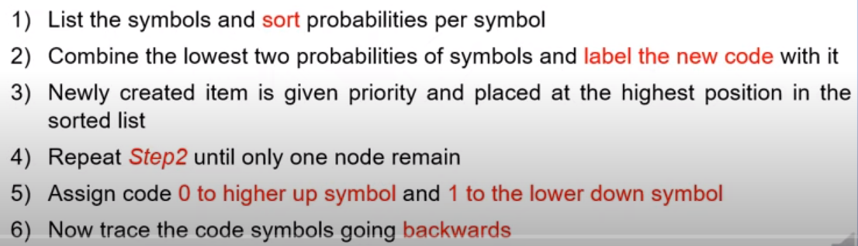
Lossless compression - Huffman algorithm

Slide 3
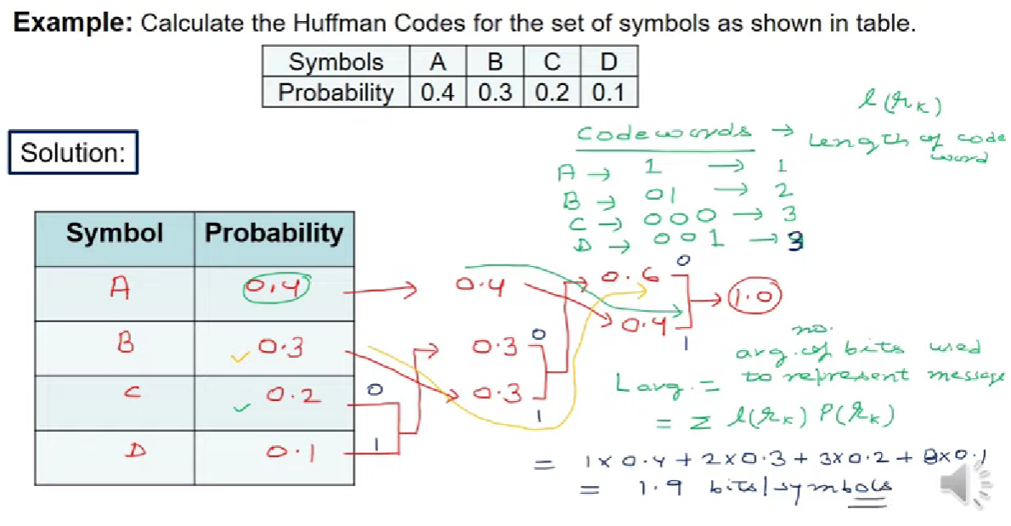

Slide 4
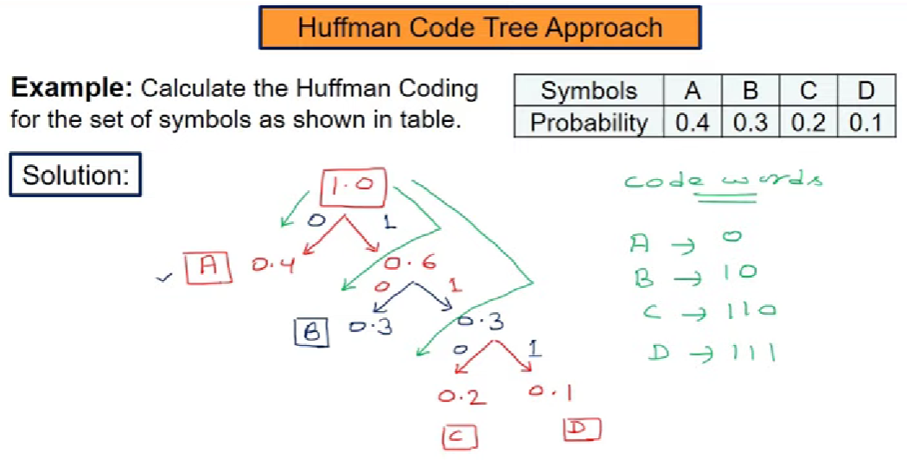

Slide 5
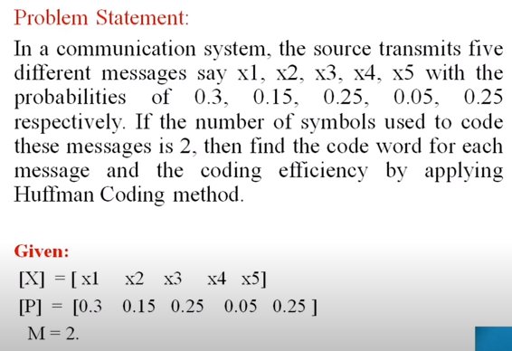

Slide 6
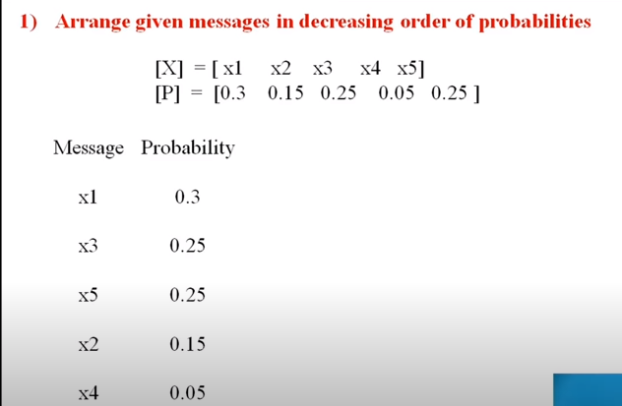

Slide 7
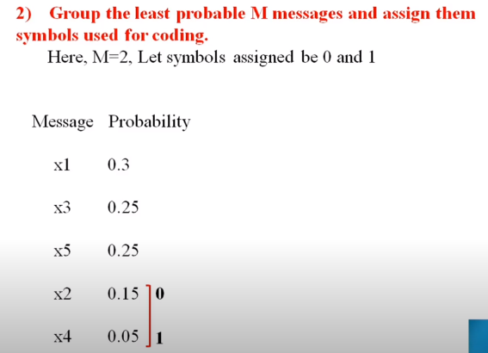

Slide 8
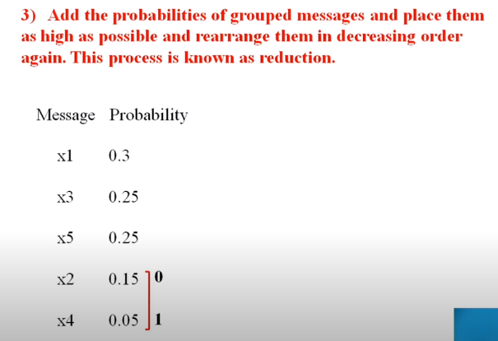

Slide 9
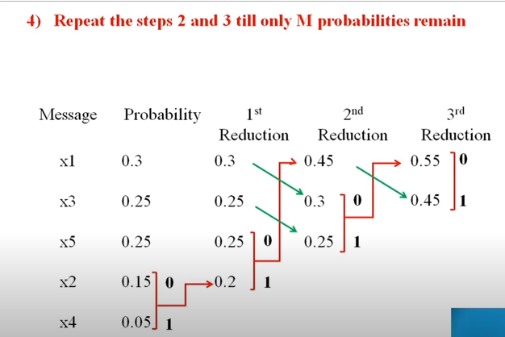

Slide 10
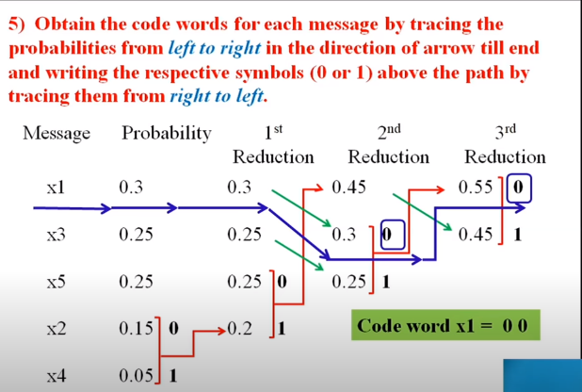

Slide 11
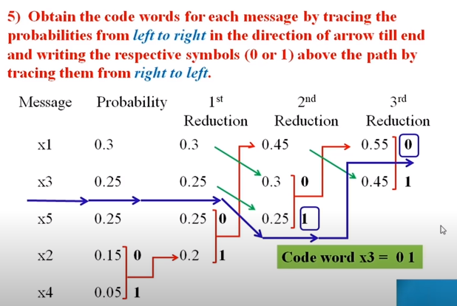

Slide 12
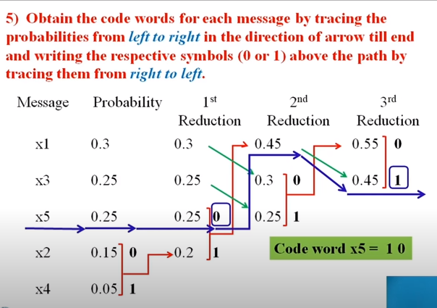

Slide 13
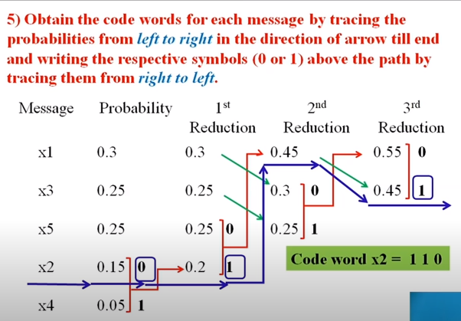

Slide 14
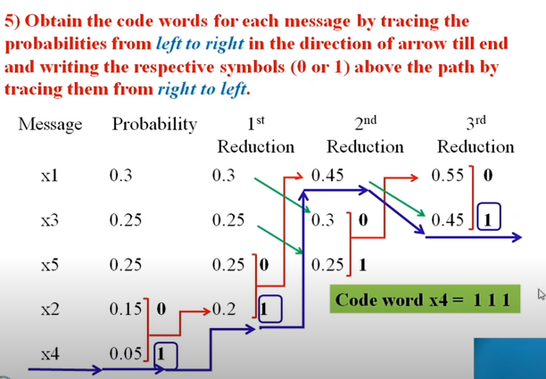

Slide 15
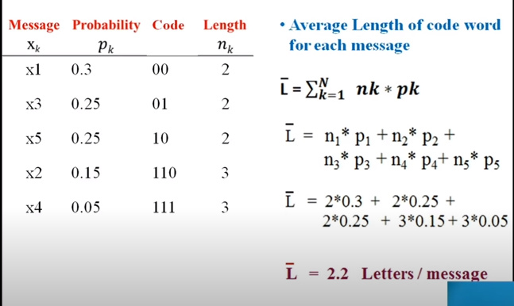

Slide 16
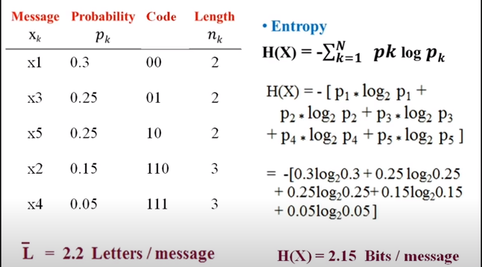

Slide 17
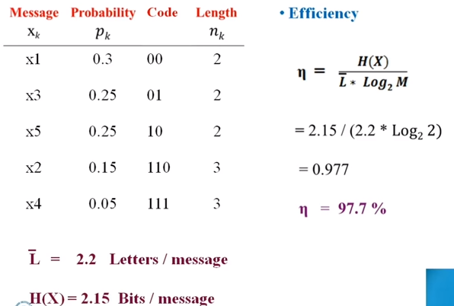
Inversely proportional

Slide 18
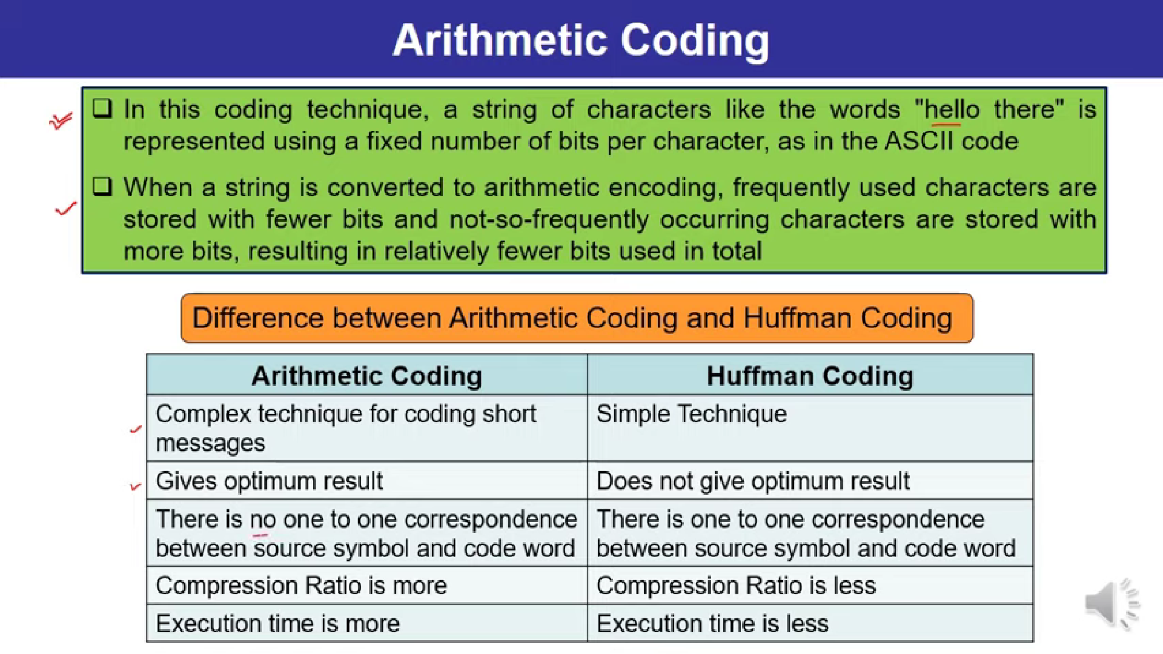
Lossless compression

Slide 19
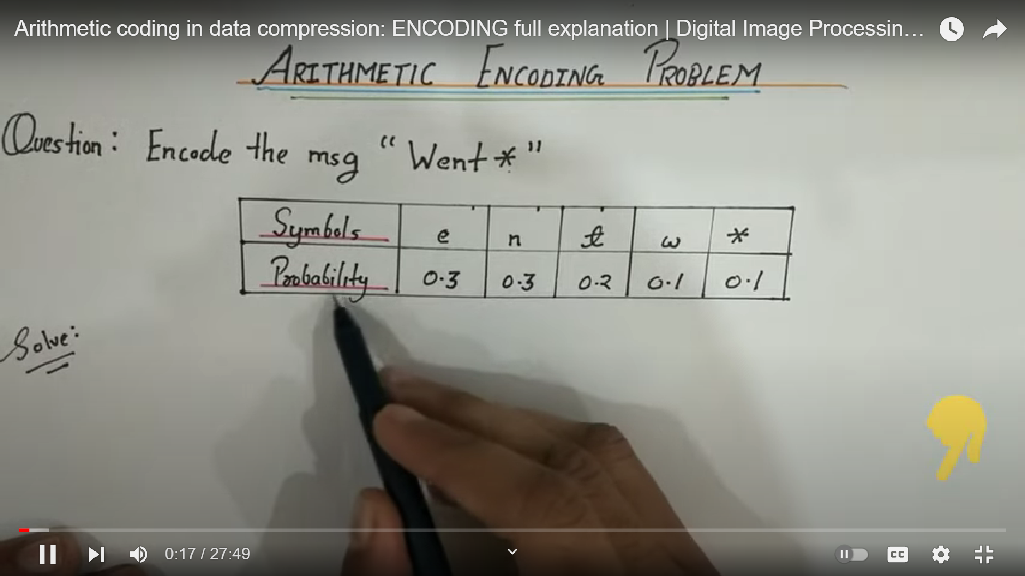
https://youtu.be/G6u8bt5unZk?si=wcin5WFkPwcU7OiG

Slide 20
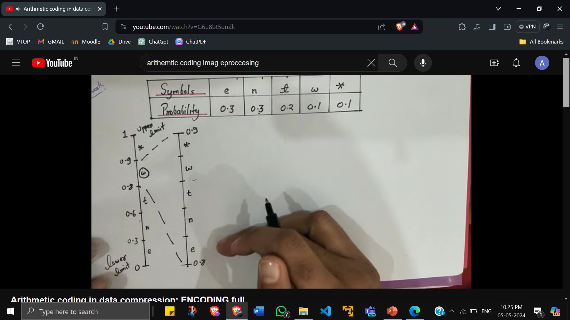

Slide 21
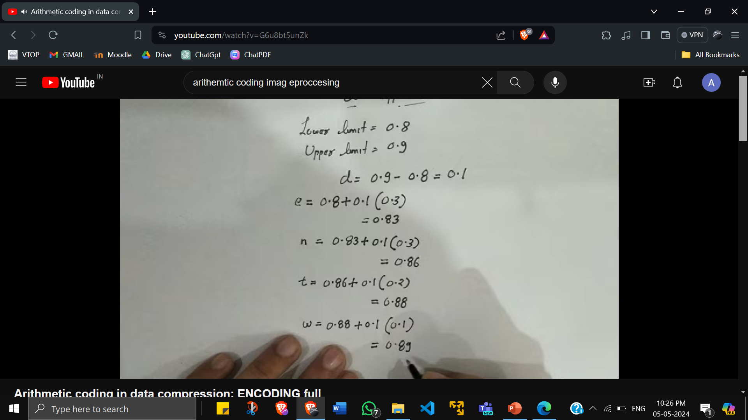
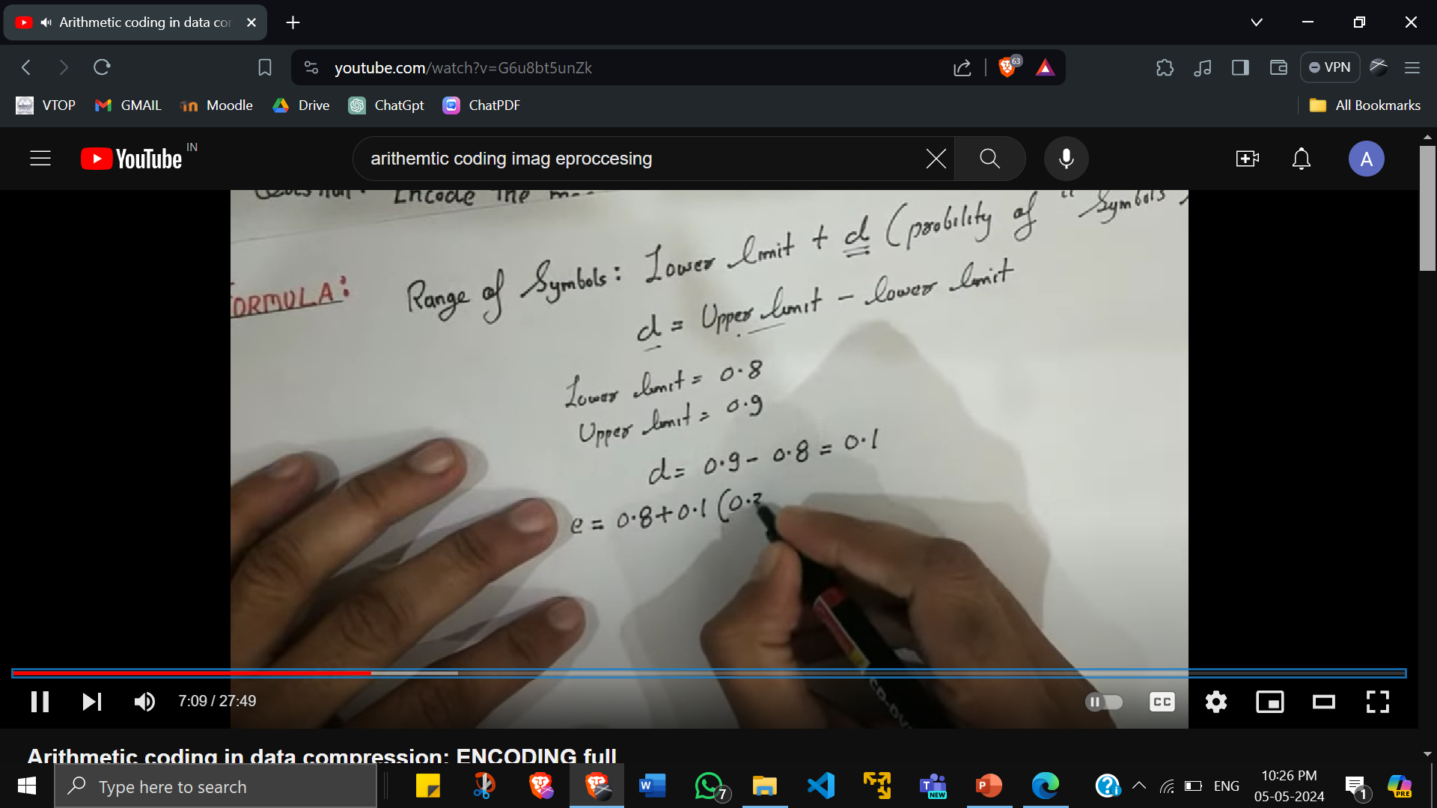

Slide 22
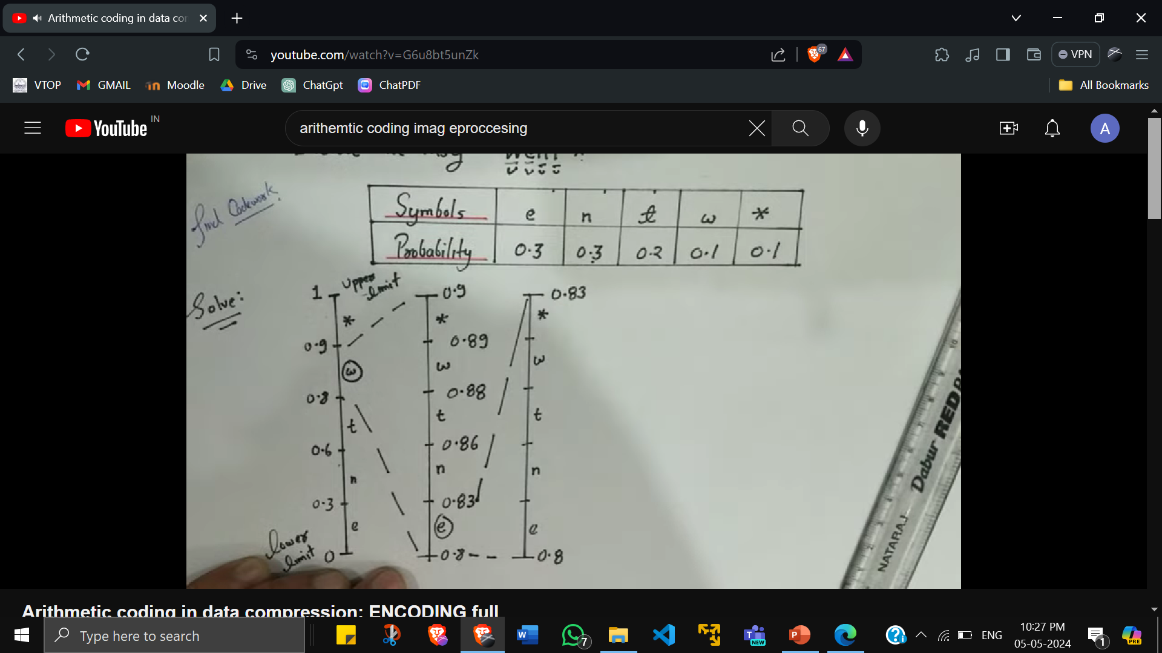

Slide 23
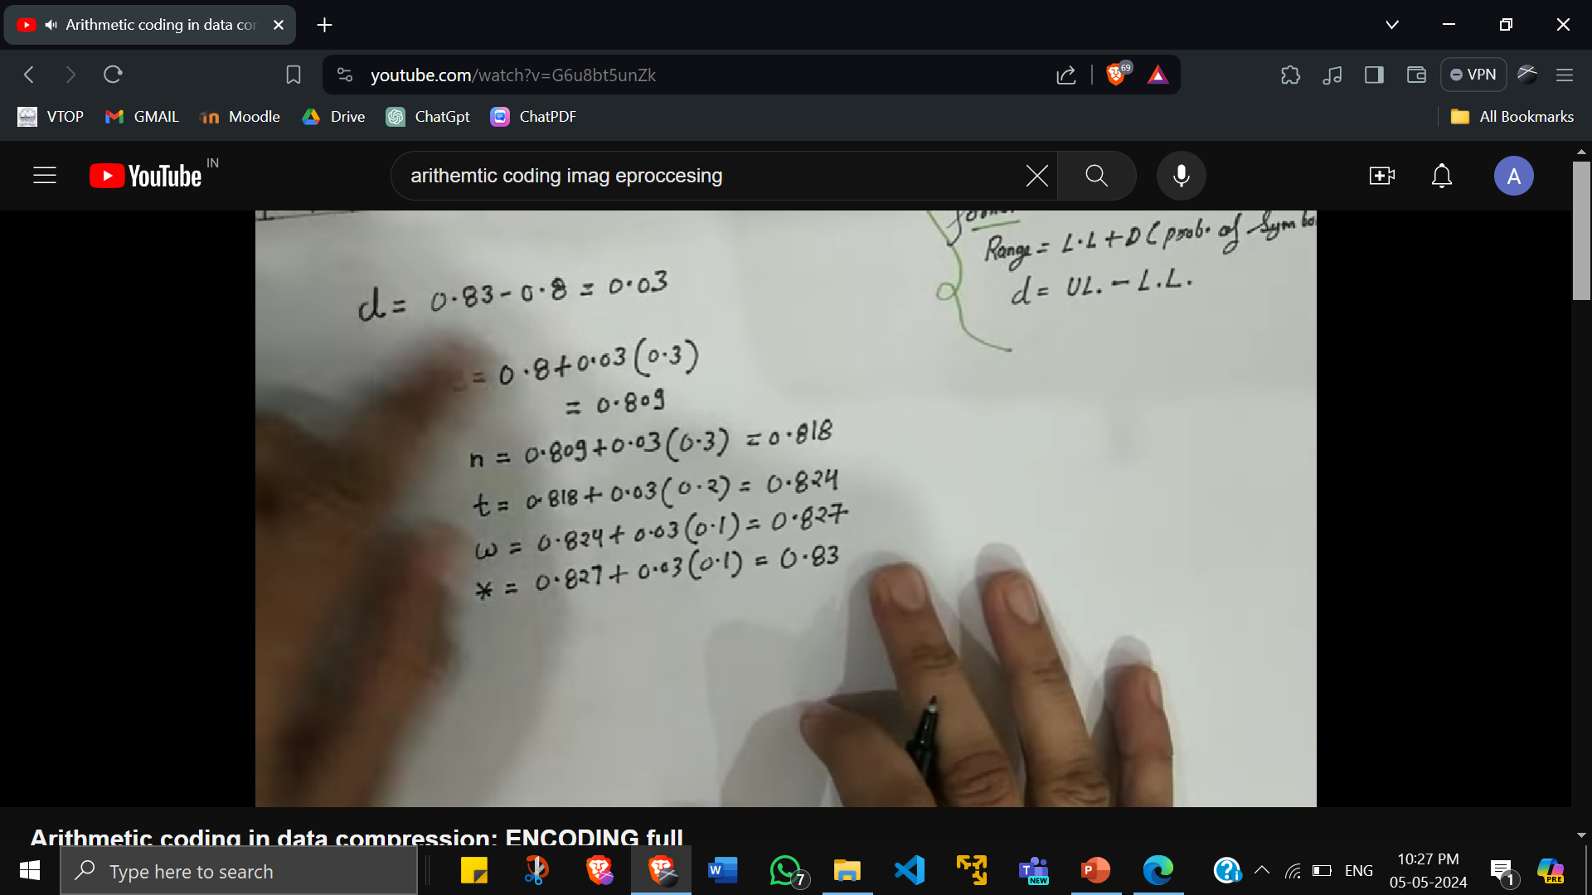

Slide 24
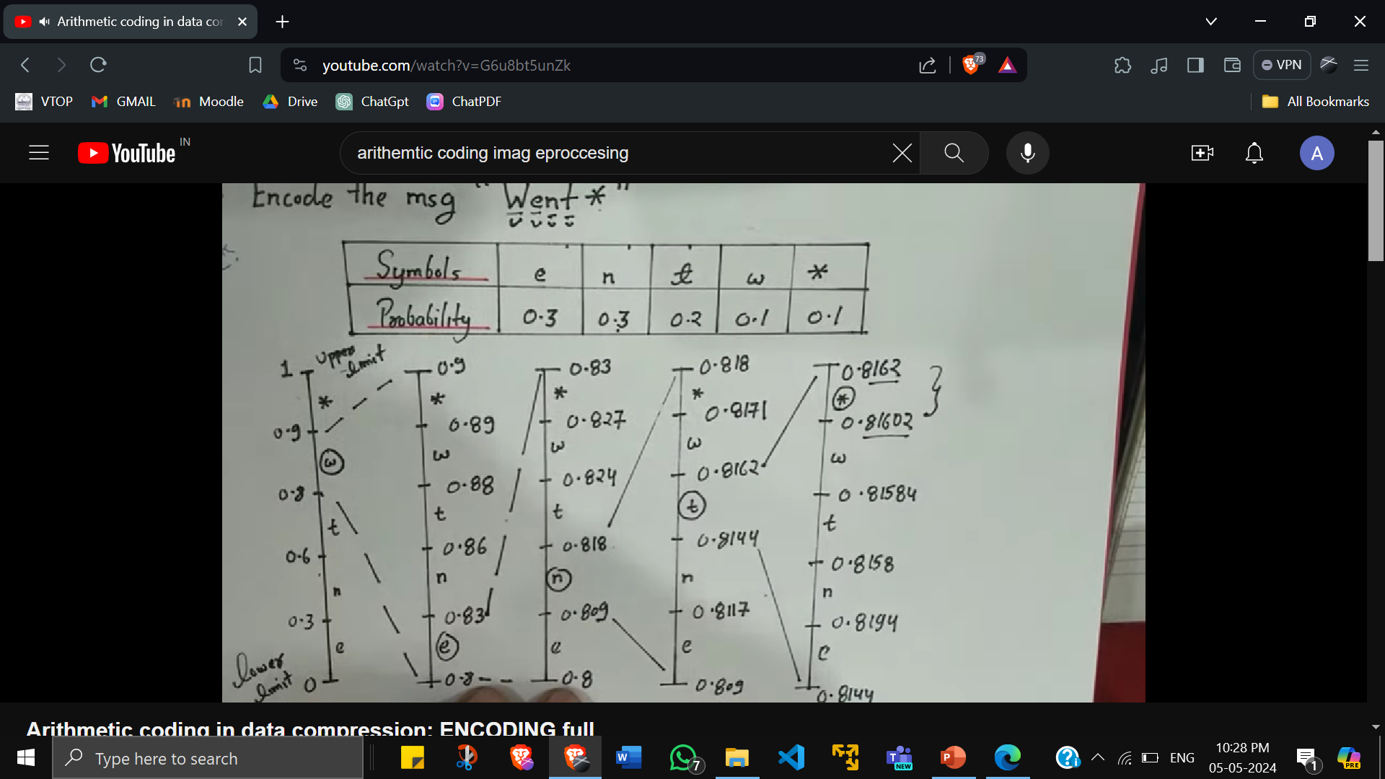

Slide 25
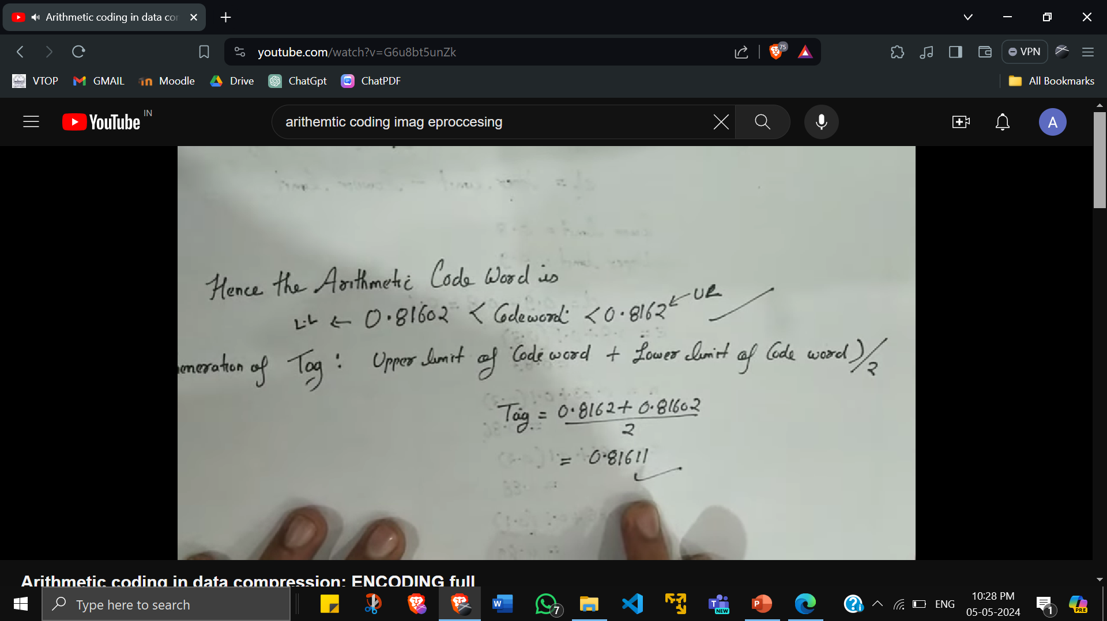

Slide 26
